Slide 1

IntelliFarm
A Farm Supervision & Productivity Analysis Platform
Group Members: Supervisor:
Agha Durrez Khan [20SW075] (G.L) Dr. Naeem Mahoto
Junaid Aslam [20SW084]

Slide 2

Table of Contents
Introduction
Relevant Works
Problem Statement
Solution
Aim / Objective
Methodology
Tools & Technologies
UI Design
Testing
Benefits
Conclusion
References

Slide 3
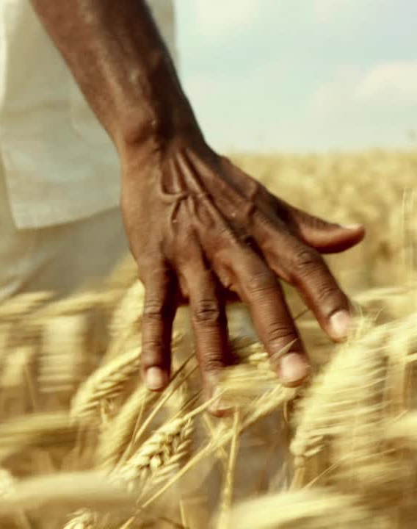
Introduction
The practice of growing crops or raising animals is known as agriculture
In Pakistan, 27% of the total land is used for agriculture, 42.3% of the total labour force is employed in agricultural pursuits and agriculture also accounts for 18.9% of the national GDP.[1]
Yet there are several issues associated with the management of agricultural land.

Slide 4
Relevant Work
WORK | SUMMARY | RELEVANCE
[2] xFarm | A farm management platform designed to simplify agricultural operations through data organization and reporting, providing accessible tools for monitoring and optimizing farm activities. | Relevant due to of its use of financial reports, which IntelliFarm provides to its users.
[3] AGRIVI | A digital farm management solution offering tools for crop planning, monitoring, and analysis, helping farmers improve productivity and achieve sustainability. | Agrivi’s crop monitoring and reporting reinforce IntelliFarm’s emphasis on informed decision-making.

Slide 5
Relevant Work
WORK | SUMMARY | RELEVANCE
[4] FarmERP | An advanced farm management software focused on enterprise-level farming, providing tools for crop planning, financial tracking, and operational management to optimize agribusiness processes. | Relevant to our app because IntelliFarm includes crop tracking and finance tracking.
[5] Farmbrite | A versatile farm management platform offering features like crop and livestock tracking, financial planning aimed at streamlining agricultural operations. | Farmbrite’s financial tools and reports echo IntelliFarm’s focus on simplicity and operational efficiency

Slide 6
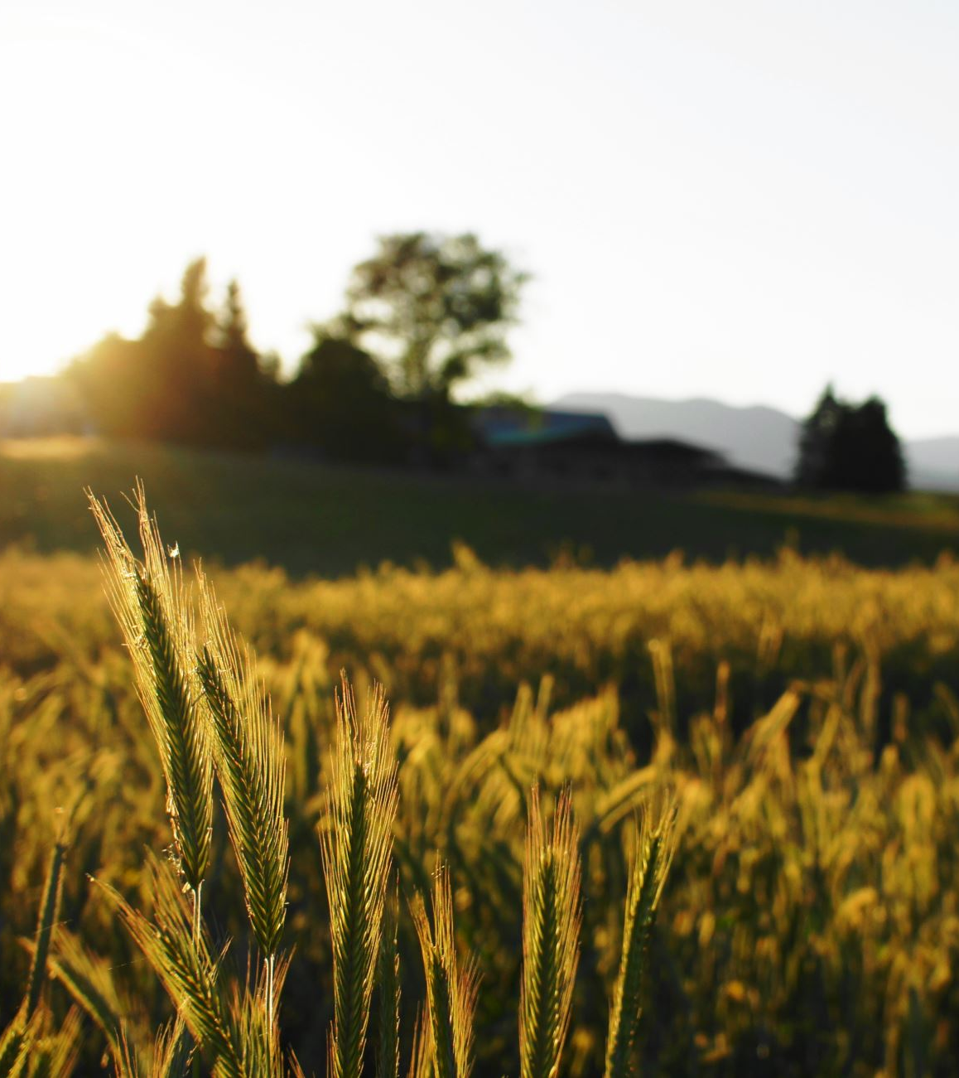
Problem Statement
Inefficient traditional approaches to land management
Lack of effective communication between various stakeholders such as landlords and farmers
Lack of innovation and limited integration of technology
Farmlands are unable to reach their full potential in terms of productivity

Slide 7
Solution: IntelliFarm
A centralized farmland management system
Built-In Financial Tracking & Reporting
Offline Functionality
User-Friendly Interface
Allows for Data Synchronization
Facilitates Improved Decision-Making
Notes:
NOTE: We are developing this system via incremental approach

Slide 8

Aim / Objective
The aim of our system is to give a Landlord the tools necessary to maximize productivity of Farmlands thereby increasing revenue and strengthening the local economy.

Slide 9
Methodology
NO | PHASE | DESCRIPTION
1. | Requirement Gathering | Gathering the requirements for the app. This Phase involved understanding the technical requirements for the app, such as the platforms and technologies it should be built on.
2. | Requirement Specification | Filtering and organizing the collected information into a Software Requirement Specification (SRS) document was the main goal of this phase.
3. | Design | The purpose of this phase was to Select an appropriate architectural style and design the interface of the system.
4. | Development | This phase dealt with the overall development of the system.
5. | Testing | Involved testing the system to detect and remove all defects, bugs and errors. By running it through specially designed test suites.

Slide 10
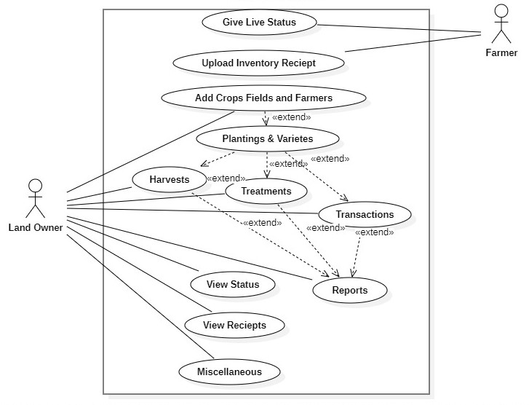
Use-Case Diagram

Slide 11
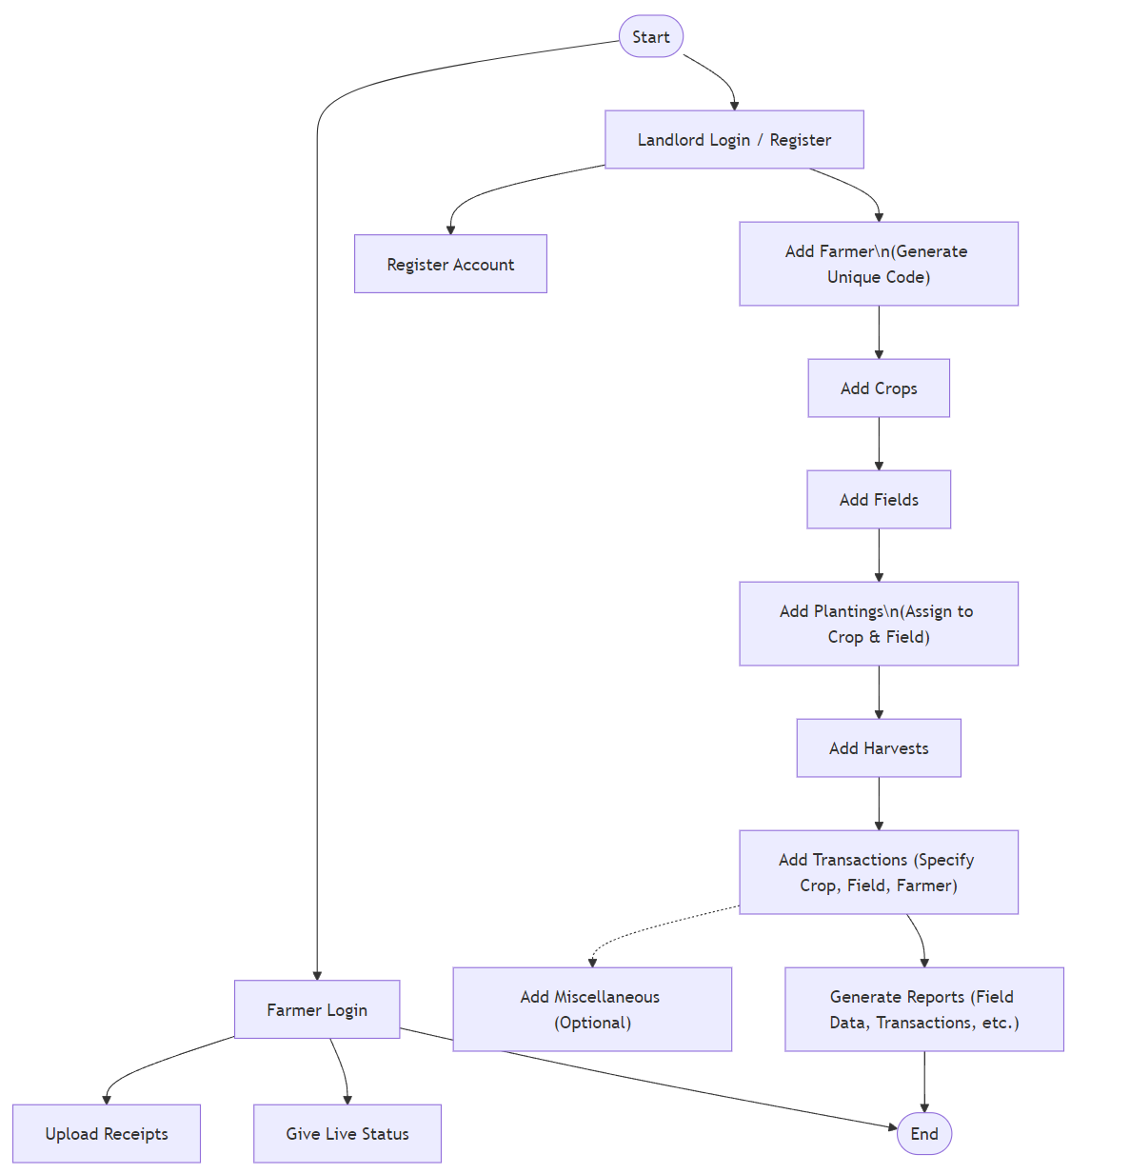
Flowchart

Slide 12
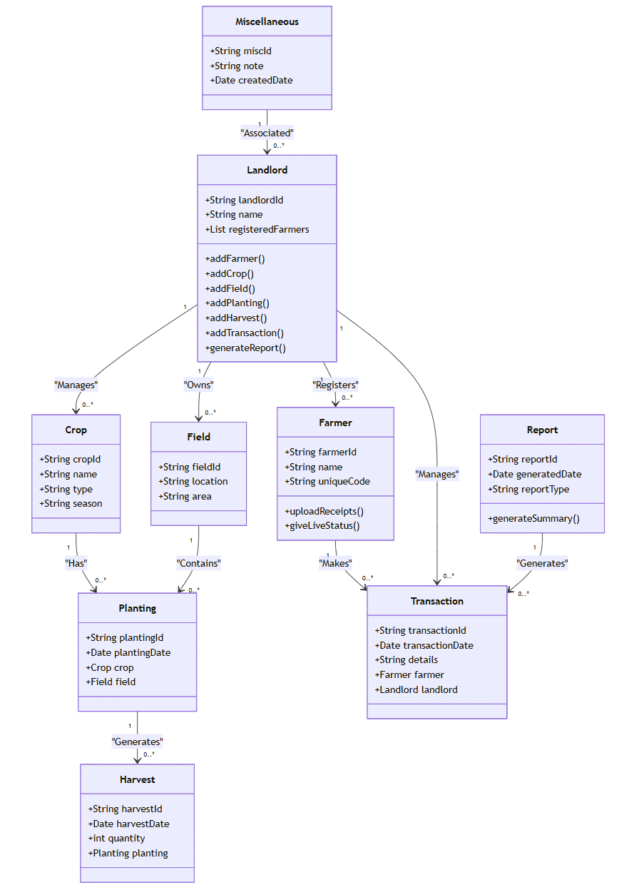
Class Diagram

Slide 13


Tools & Technologies
Main IDE: Visual Studio Code
Development Framework: Flutter
Version Control System: GitHub
Database: Firebase

Slide 14
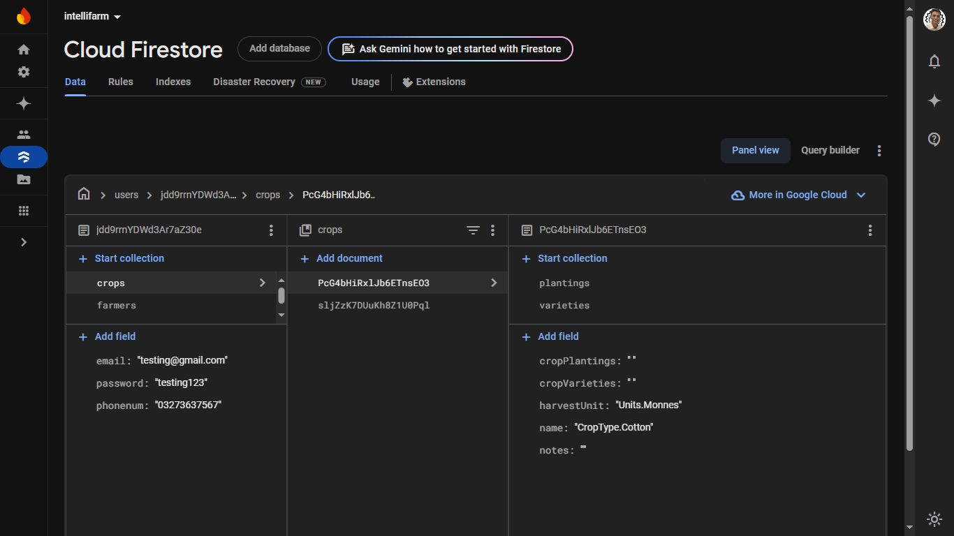
Database

Slide 15
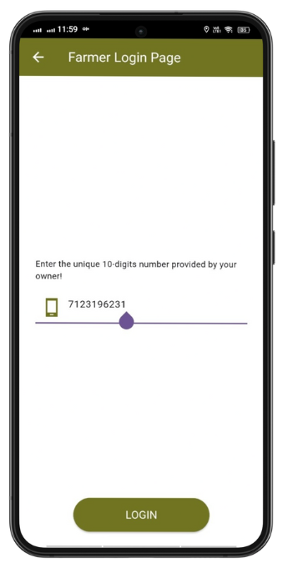
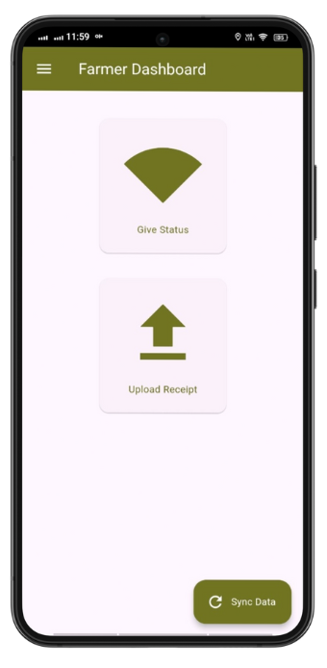
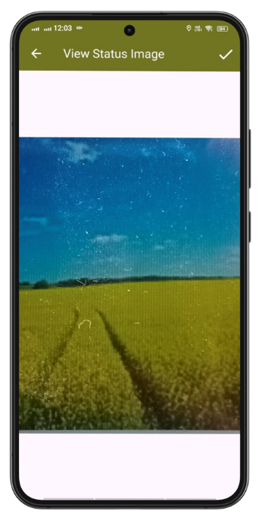
UI Design

Slide 16
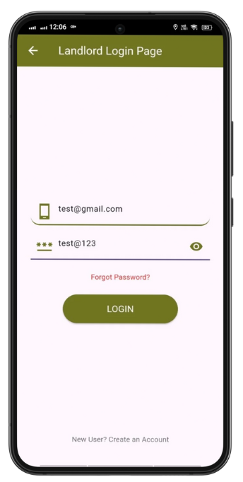
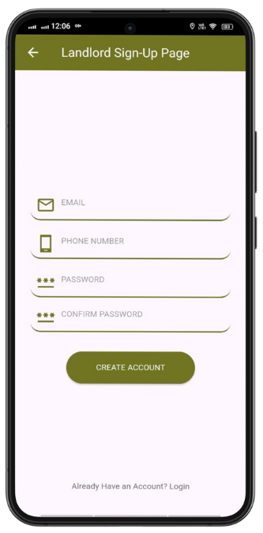
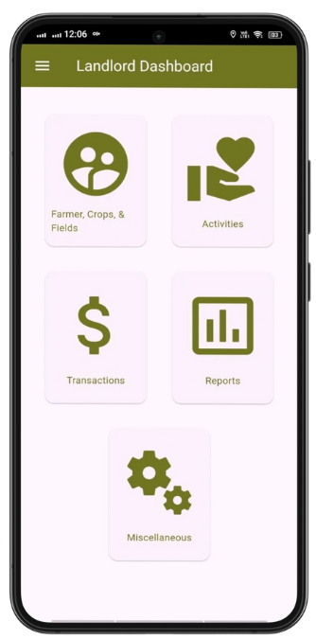
UI Design

Slide 17
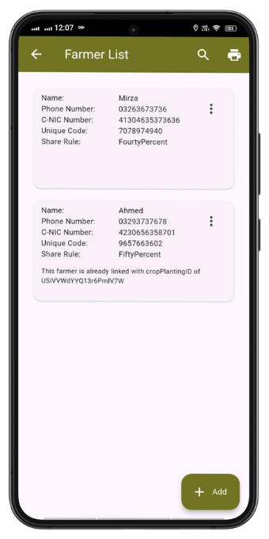
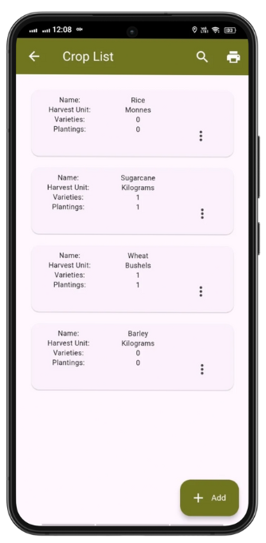
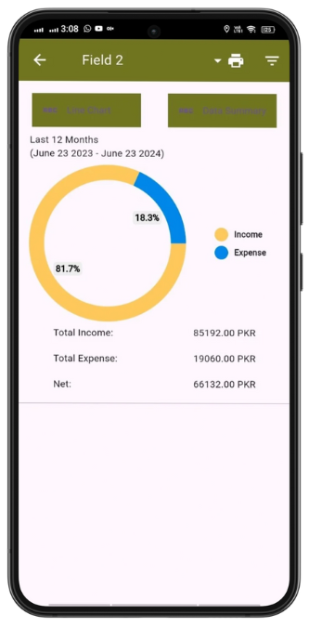
UI Design

Slide 18
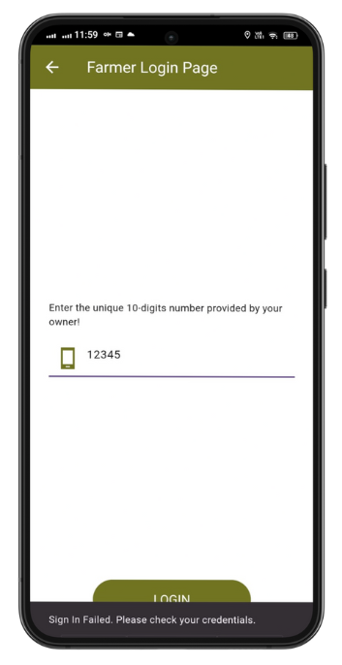
Testing
S/N | Input | Expected Outcome | Actual Outcome | Test Result (Pass/Fail)
1 | Unique Code: 1234567890 | Farmer logs in successfully and is redirected to their dashboard. | Farmer logged in successfully and was redirected to their dashboard. | Pass
2 | Unique Code: 9876543211 (not assigned) | Error message: "Invalid unique code. Please try again." | Error message: "Invalid unique code. Please try again." Was displayed. | Pass
3 | Unique Code: 12345 | Error message: "Unique code must be exactly 10 digits." | Error message: "Unique code must be exactly 10 digits." Was displayed. | Pass
4 | Unique Code: 12345abc90 | Error message: "Unique code must be numeric." | Error message: "Unique code must be numeric." Was displayed. | Pass

Slide 19
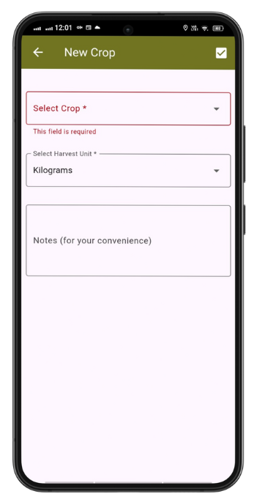
Testing
S/N | Input | Expected Outcome | Actual Outcome | Test Result (Pass/Fail)
1 | Crop Name: Wheat, Harvest Unit: kg, Notes: Optional | The crop "Wheat" is added and appears in the crop list. | The crop "Wheat" was added and appeared in the crop list. | Pass
2 | Crop Name: [Empty], Harvest Unit: [Empty] | Error message: "Please fill all required fields." | Error message: "Please fill all required fields." Was displayed. | Pass
3 | Crop Name: Wheat (already exists), Harvest Unit: kg | Error message: "Crop name already exists." | Error message: "Crop name already exists." Was displayed. | Pass
4 | Add Crop and navigate to Crop List screen | Newly added crop is visible in the list. | Newly added crop was visible in the list. | Pass

Slide 20
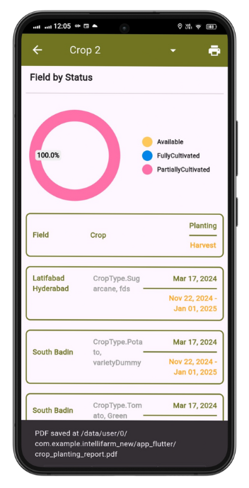
Testing
S/N | Input | Expected Outcome | Actual Outcome | Test Result (Pass/Fail)
1 | Filter by Date: 2024-01-01 to 2024-02-01 | A filtered report is generated displaying relevant transactions. | A filtered report was generated which displayed relevant transactions. | Pass
2 | Click Download Button for Generated Report | Report is downloaded in PDF format. | Report was downloaded in PDF format. | Pass
3 | Open Downloaded Report | Report displays correct data, structure, and formatting. | Report displayed correct data, structure, and formatting. | Pass

Slide 21
Benefits
Centralized Management:
Improved Financial Oversight:
Enhanced Data Accessibility:
Actionable Insights:
Improved Productivity and Cost Savings:
Support for Remote Users:

Slide 22
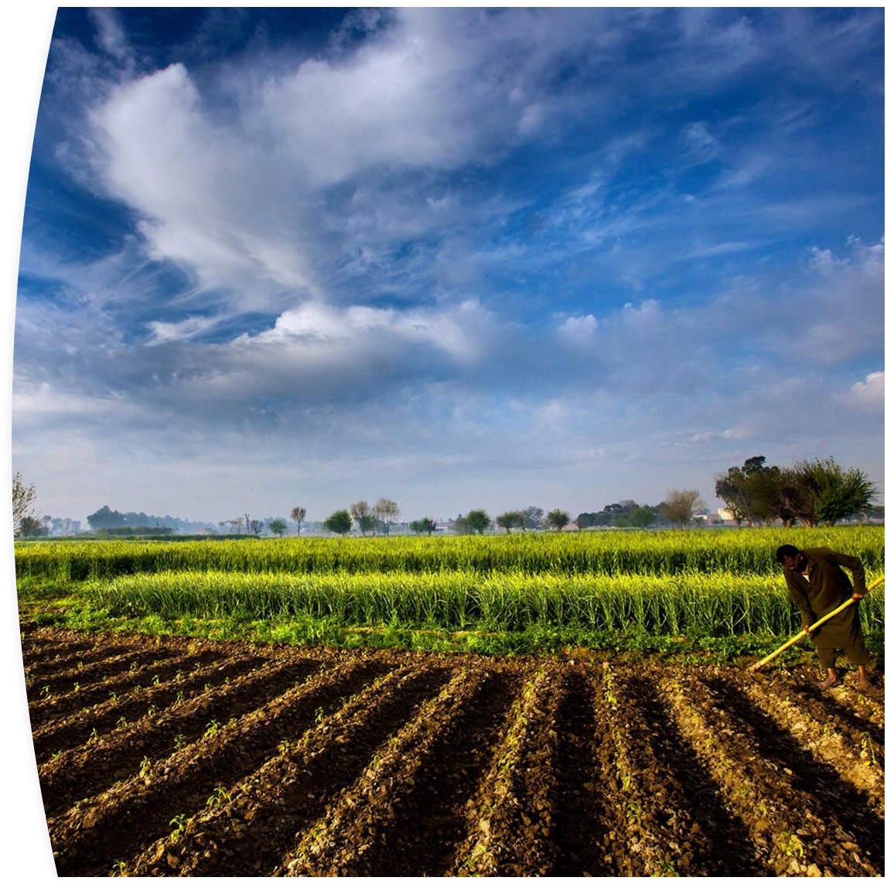
Conclusion
IntelliFarm is a Farm Supervision & Productivity Analysis Platform that allows Landlords to easily supervise and manage all agricultural activities on their Farmlands in a centralized and unified way.

Slide 23
References
[1] https://www.finance.gov.pk/survey/chapters_18/02-Agriculture.pdf
[2] https://xfarm.ag/en
[3] https://www.agrivi.com/
[4] https://www.farmerp.com/
[5] https://www.farmbrite.com/

Slide 24

Teamwork / Individual Efforts
Both of us have jointly developed both the App and write the Thesis.
With regards to our project we have used GitHub to collaborate in development.

Slide 25
THANK YOU

